Slide 1
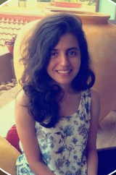
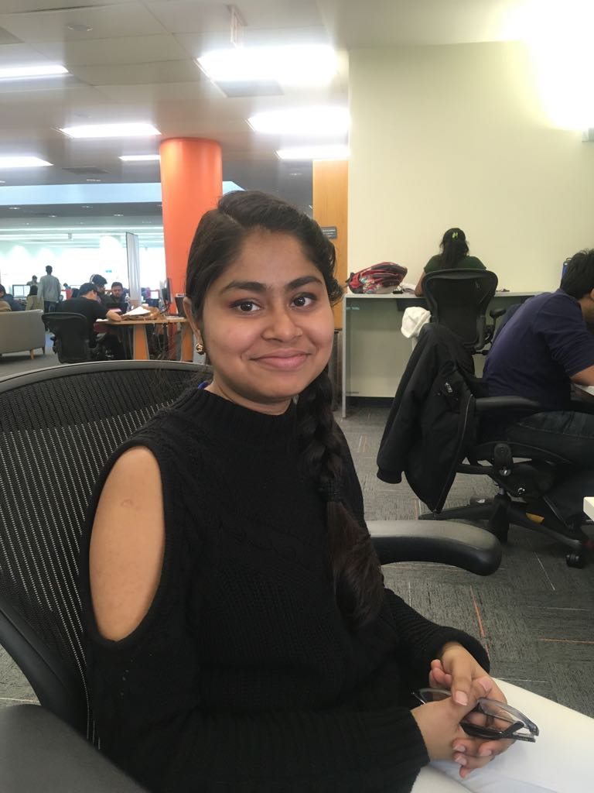
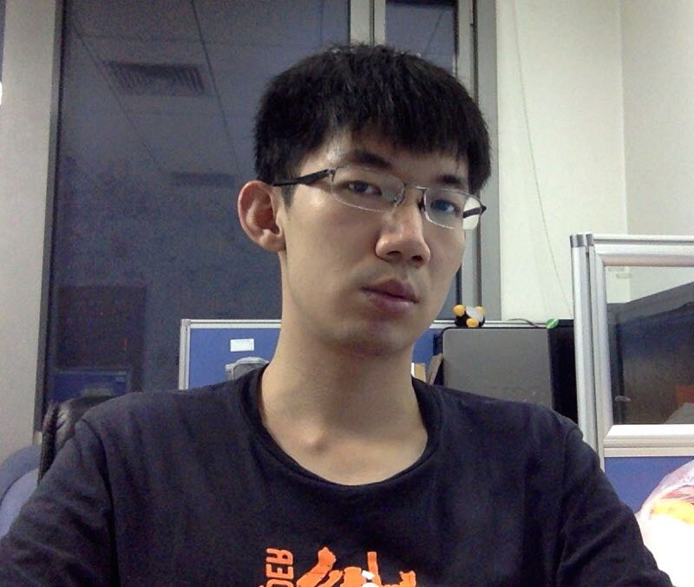
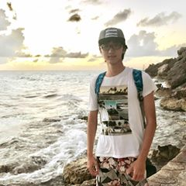

NAVIGATE A GAME USING MOTION DETECTION THROUGH OPTICAL FLOW ALGORITHM
THE TEAM
Saniya Sudhir Alekar, MS, Computer Science
Titash Mandal, MS, Computer Science
Sen Huo, MS, Computer Science
Hanzhao Wang, MS, Computer Science

Slide 2
WHAT IS OPTICAL FLOW?
Optical flow is the pattern of apparent motion of objects, surfaces, and edges in a visual scene caused by the relative motion between an observer and a scene.
Sequences of ordered images allow the estimation of motion as either instantaneous image velocities or discrete image displacements. The optical flow methods try to calculate the motion between two image frames which are taken at times t and t+ Δt at every pixel position.
Lucas–Kanade method is a widely used differential method for optical flow estimation. It assumes that the flow is essentially constant in a local neighbourhood of the pixel under consideration, and solves the basic optical flow equations for all the pixels in that neighbourhood, by the least squares criteria.
Lucas-Kanade method takes a 3x3 patch around the point. So all the 9 points have the same motion. We can find (fx,fy,ft) for these 9 points. So now our problem becomes solving 9 equations with two unknown variables which is over-determined. A better solution is obtained with least square fit method.

Slide 3
TOOLS USED FOR THE PROJECT
Programming in Python
Pygame library to design the game
Opencv2
A Colored ball to test tracking
Webcam of the laptop

Slide 4
Project Formulation
Detecting the Webcam of the laptop
The program first detects the webcamera of the laptop to process the video frame for specific object detection.
Calculating Optical Flow
The opencv library provides this method to calculate optical flow for a sparse feature set using the iterative Lucas-Kanade method with pyramids.
Iterative Step
We pass the previous frame, previous points and next frame. It returns next points along with some status numbers which has a value of 1 if next point is found, else zero. We iteratively pass these next points as previous points in next step.

Slide 5
Project Formulation
Specific Object Detection using color
To restrict detection of motion for only a specific object, we use the hsv (hue, saturation, and value) values for the color green specific to our program.
Further Steps
We take each frame of the video and convert the frame from BGR to HSV color-space. We then threshold the HSV image for a range of green color. Then we extract the green object in the frame and process it.
Determining contours around the object detected.
We use the method cv2.findContours to find the contour of the object and draw a circle around it. This method takes in a parameter cv2.RETR_TREE to computer the hierarchy between the contours. The method gives us the list of contours it has found.

Slide 6
Project Formulation
Calculating the centroid of the green object
We used the method cv2.moments(), which helps to determine the center of the object which will be required to track the movement to navigate the game.
Determine the direction of movement
To determine whether the object is moving – “UP”, “DOWN”, “ LEFT” or “RIGHT”, we extract the x and y co-ordinates of the two positions of the object and compare them to link its movement to the keyboard activity.
We take each frame of the video and convert the frame from BGR to HSV color-space. We then threshold the HSV image for a range of green color. Then we extract the green object in the frame and process it.
Navigate the game using motion detection
Finally we link our program to a game and navigate it using the motion detection. The direction of movement is also printed on the terminal to check the accuracy of the program.

Slide 7
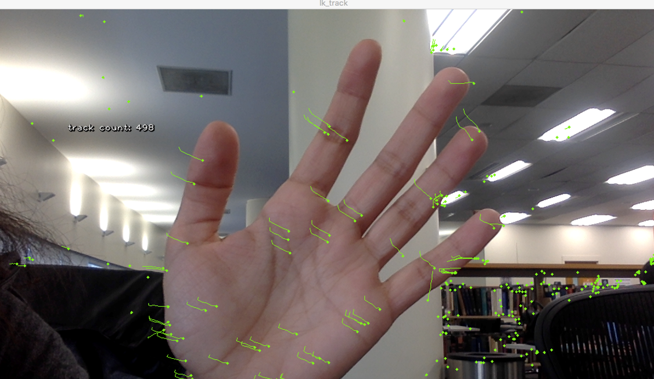
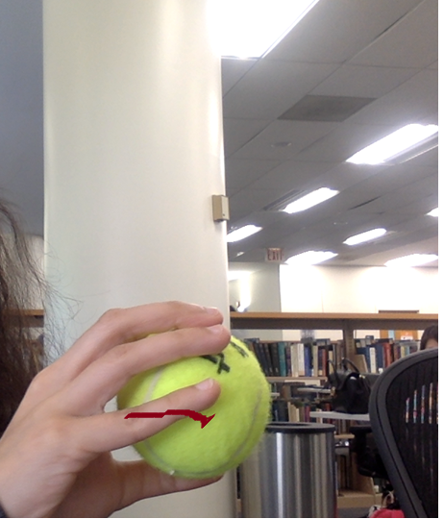
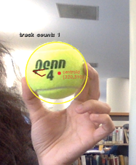
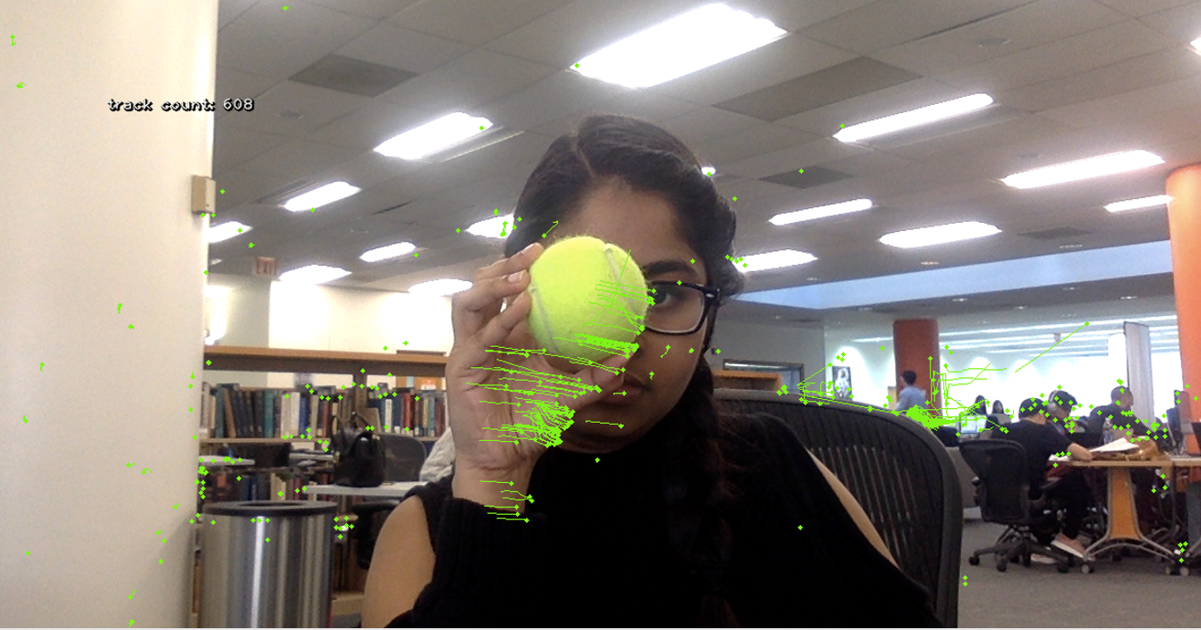
Output of the initial program which tracks motion of multiple points in frame.
Output of the program after thresholding based on color and velocity.

Slide 8
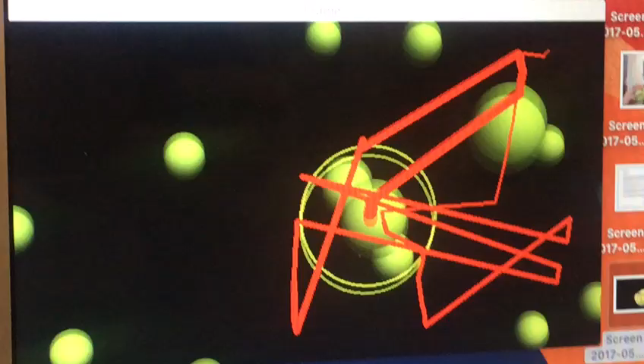
Applying the Lucas Kanade Algorithm on a video.

Slide 9
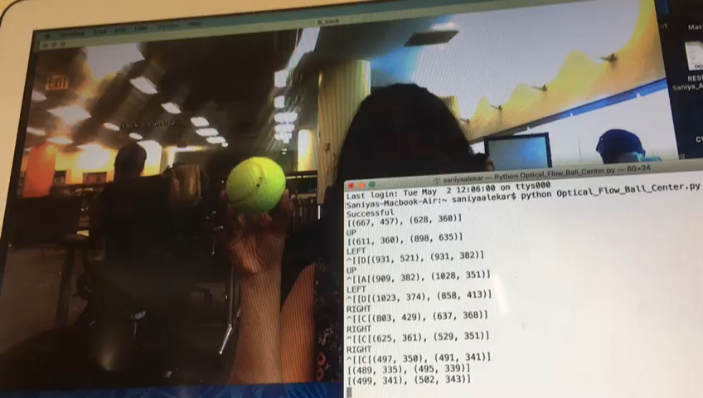
Video showing the output of the final program.

Slide 10
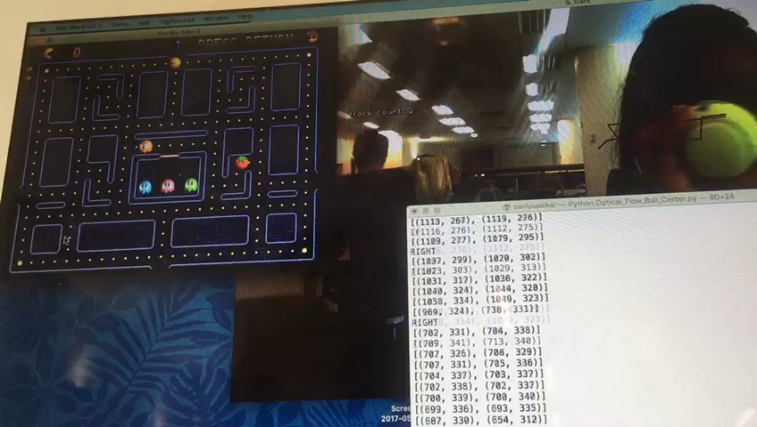
MOTION DETECTION USED TO NAVIGATE THE PACMAN GAME.

Slide 11
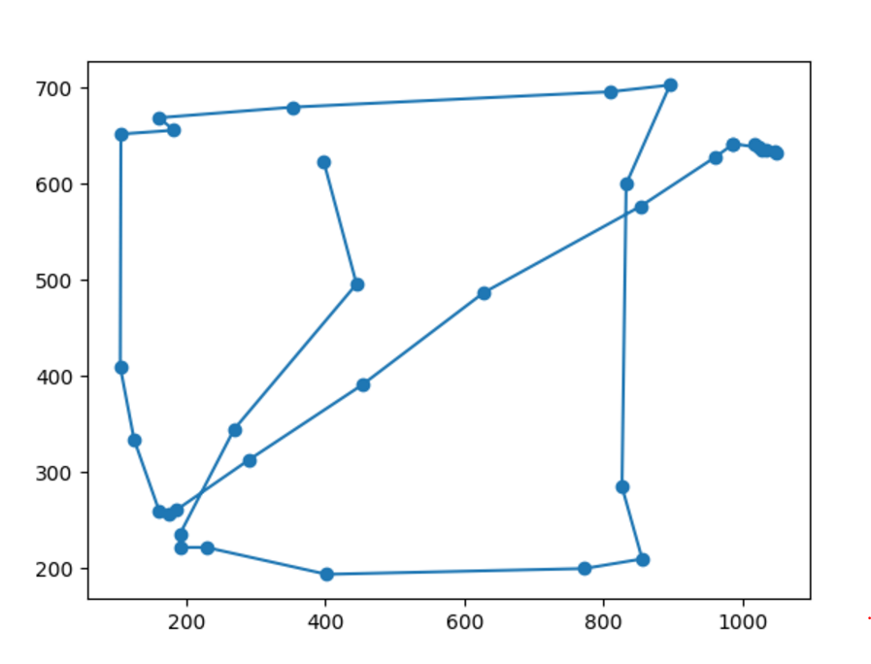
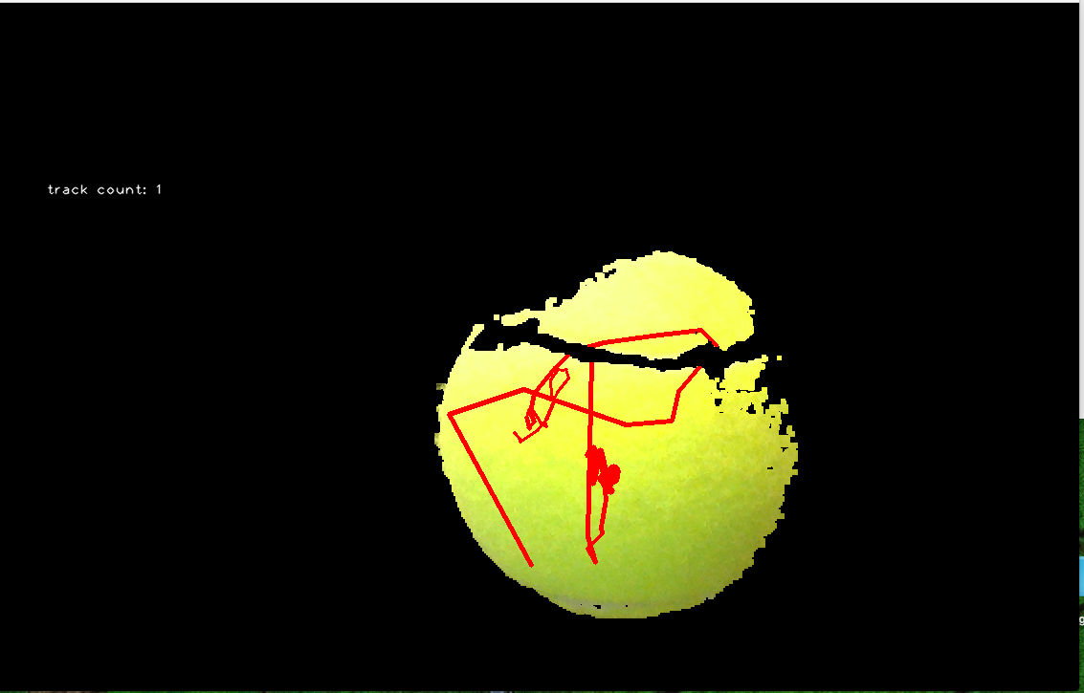
MORE OUTPUTS OF THE PROGRAM
Mask applied to the image to only detect the ball.
Graph generated to detect the direction of movement of hand while playing the game

Slide 12
Comparison between the initial stage of the project and the final stage of the project
PROGRAM STAGE- I | FINAL PROGRAM
The method “cv2.goodFeaturesToTrack()” returns the set of points on the frame whose motion is to be tracked. | The final program uses ‘THRESHOLDING HEURISTIC” (hsv color values) to restrict motion detection to only a specific object.
As the initial program tracks the motion of several objects in frame, we need a large database to store all the point and then determine it’s velocity vector. This process isn’t very feasible. | The detection is restricted to a specific color. Hence a smaller “collection” is required to store their co-ordinates and determine velocity vector- “UP”, “DOWN”, “RIGHT”, “LEFT”.
There is a time lag in motion detection because of the large number of points moving in frame. | This program is relatively faster and very optimized.
Intial Stage
Final Stage
Specific
Possible
Fast
29
Very Slow
Direction an be tracked n
100-450
Too large Database needed
5
Time Lag in detection
15
Motion
direction Tracking
Objects detected

Slide 13
CONCLUSION
In this project, we could study and implement an interesting computer vision technique to reconstruct the motion between frames of a video sequence. The reconstruction of the Optical Flow allow us to estimate the displacement of moving objects of a scene over time.
The inter frame motion was taken to be small, that’s one of the fundamental property used by the method to allow reconstruction of motion. Thus the reconstructed vector field was obtained to be correctly displayed on this document.
The Lucas Kanade algorithm correctly detects the points in the frame however a thresholding heuristic was used to optimize the program for our application.
The calcOpticalFlowPyrLK function can detect false positive hence the same method is used in the second frame to estimate the characteristics in the first frame. With this, characteristics common to both are acquired which are the correct tracking characteristics in the second frame.
Deployment
In-production services
Advanced projects

Slide 14
FUTURE GOALS
We would like to extend our program in detecting the motion of hands.
We would also like to resolve the time lag between motion and detection of movement trying to improvise the Horn and Schnuk Algorithm.
We also want to design our game in python and test our project to see the output.

Slide 15
THANK YOU

